Slide 1
Math Misconceptions
Utah Standards Academy
Summer 2014

Slide 2
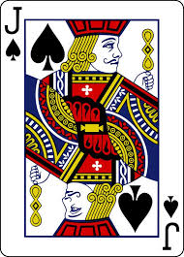
Counting
Johnny, a Kindergarten student was in class and said to his teacher I am very good at counting. She replied, “Oh yeah, let me hear.” Johnny said “2,3,4,5”. The teacher said, “That is wonderful.” Johnny, excited from her response, asked if she wanted to hear more. Being a great teacher she said yes. He counted 6,7,8,9. The teacher encouraged him to keep going. Johnny then said “10, Jack”. “See, I can count all the way to Jack.”
Notes:
2 minutes total for slides 2 and 3.

Slide 3
What are misconceptions?
A misunderstanding that students get when they hear incorrect math, form faulty thinking, or are taught shortcuts that remove math concept development.

Slide 4
Students come to us with misconceptions
What misconceptions do students have before they get to school?
How do these misconceptions effect math instruction?
How do we get rid of the misconceptions?
How do we avoid misconceptions?
Notes:
5 minutes. Some misconceptions include : Counting to a million or a million zillion, Trying to apply the digits 0-9 to a clock without understanding beyond 9, Measuring tool, money, saying things they hear adults say such as reading 2010 as two thousand and ten, It should be read two thousand ten.

Slide 5
“The worst thing about mnemonics is not that they almost always fall apart, they don’t encourage understanding, and never justify anything; it’s that they kill curiosity and creativity - two important character traits that too many math teachers out there disregard.” -Andy Martinson
Notes:
1 minute. Read and ask for comments.

Slide 6
Misconception
Students read numbers incorrectly.
For example they say a hundred for one hundred.
They read 2010 as two thousand and ten. It should be read two thousand ten.
Notes:
20 minutes for slides 6 through 12. Why is it important for students to read numbers the correct way? Does it make a difference? Why? What problems could this cause later on? How do we fix this?

Slide 7
Misconception
Students write numbers incorrectly.
407 for forty seven.
1004 for one hundred four.
100087 for one thousand eighty seven.
2000400703 for two thousand four hundred seventy three.

Slide 8
misconception
Students get confused with the alligator/Pacman analogy. Is the bigger value eating the smaller one? Is it the value it already ate or the one it is about to eat? Do I add what it has eaten?
How can we teach this concept to avoid misconceptions?
Notes:
Ideally students have enough exposure to these symbols that they memorize the meaning. Just as they see and write = when they hear or say “equal,” students should see and write < when they hear or say “less than.” To help students before they internalize the meaning, have them analyze the shape. Instead of the segments being parallel like in an equal symbol, which has marks that are the same distance apart on both sides, the bars have been tilted to make a smaller side and a larger side. The greater number is next to the wider end and the lesser number is next to the narrower end. Beware of language here: use “greater” rather than “bigger” because when integers are brought into play “bigger” creates trouble.

Slide 9
Misconception
When students are studying integers, multiplying by 10 means to “add a zero” but once they head into the realm of real numbers the phrase changes to “move the decimal point.” Neither phrase conveys any meaning about multiplication or place value. “Add a zero” should mean “add the additive identity” which does not change the value at all!
No wonder students are totally confused when we magically change 34 to 340, explaining that “we added zero.”
34 x 10 = 340 multiplying by 10
34 + 0 = 34 adding zero

Slide 10
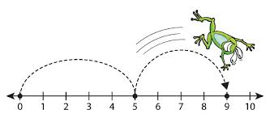
misconception
In helping students make sense of subtraction they are told to always take the smaller number away from the larger number.
4 – 8 = ?
Notes:
How can this cause problems later on?

Slide 11
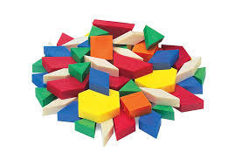
misconception
Many students think that all hexagons are yellow and have six sides and angles that are exactly the same size, because the only time they see hexagons is when they are using pattern blocks.

Slide 12
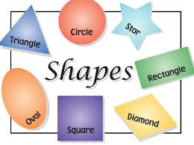
Commercially made posters
Sometimes these can support students’ misconceptions and overgeneralizations. Many children think a rectangle has to have two long sides and two short sides. This is because these are the only examples they see. This can become a problem later when they are asked to classify a variety of shapes or are told that all squares are rectangles.
Notes:
What other problems do you see on this shape poster?

Slide 13
We can prevent or minimize many common misconceptions and effectively address those that still emerge when our instruction consistently probes students’ understandings and provides opportunities for students to show and explain their reasoning. That’s the type of mathematics instruction every student deserves. ~ Steven Leinwand
Notes:
1 minute. Read and ask for comments.

Slide 14
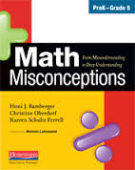
An Example
Divide into grade level groups. Read your example and discuss each section as you go. You have 20 minutes for this.
One spokesperson from each grade level will come to the front and share with the group what you discussed. Each spokesperson will have two minutes to share.
From Misunderstanding to Deep Understanding: Math Misconceptions
by Honi J. Bamberger, Christine Oberdorf and Karren Schultz-Ferrell
Notes:
30 minutes. Read counting with number words. Work through the example. Identifying the error patterns. What the research says. Ideas for instruction. Questions to ponder.

Slide 15
“I would say, then, that it is not reasonable to even mention this technique. If it is so limited in its usefulness, why grant it the privilege of a name and some memory space? Cluttering heads with specialized techniques that mask the important general principle at hand does the students no good, in fact it may harm them. Remember the Hippocratic oath - First, do no harm.” -Jim Doherty
Notes:
1 minute. Read and ask for comments.

Slide 16
Questions
What misconceptions do we deal with?
How do misconceptions effect math instruction?
How do we get rid of the misconceptions?
How do we avoid misconceptions?
How do we use misconceptions to better our instruction?
Notes:
15 minutes Have participants discuss these questions in groups. Each group makes a chart describing what they talked about. Wrap-up with the whole class.

Slide 17
Effective teachers have always understood that mistakes and confusion are powerful learning opportunities. Moreover, they understand that one of their critical roles is to anticipate these misconceptions in their lesson planning and to have at their disposal an array of strategies to address common misunderstanding before they expand, solidify, and undermine confidence. ~ Steven Leinwand

